Slide 1





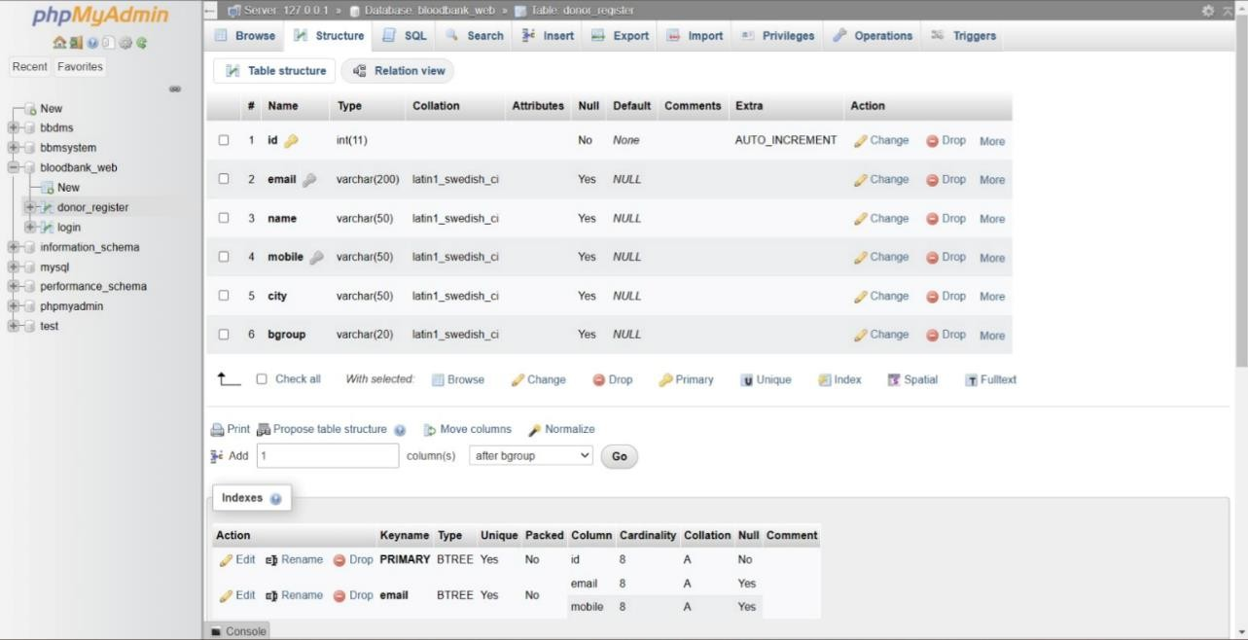


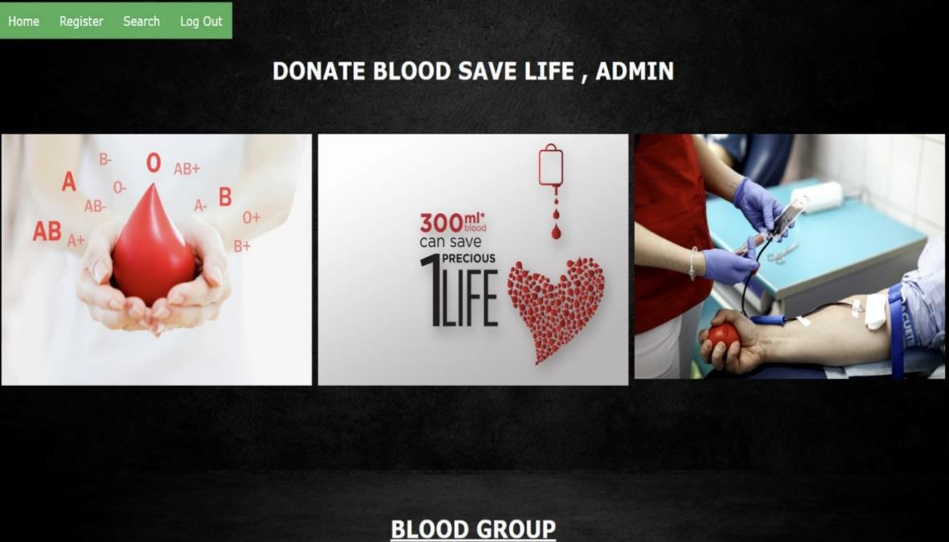
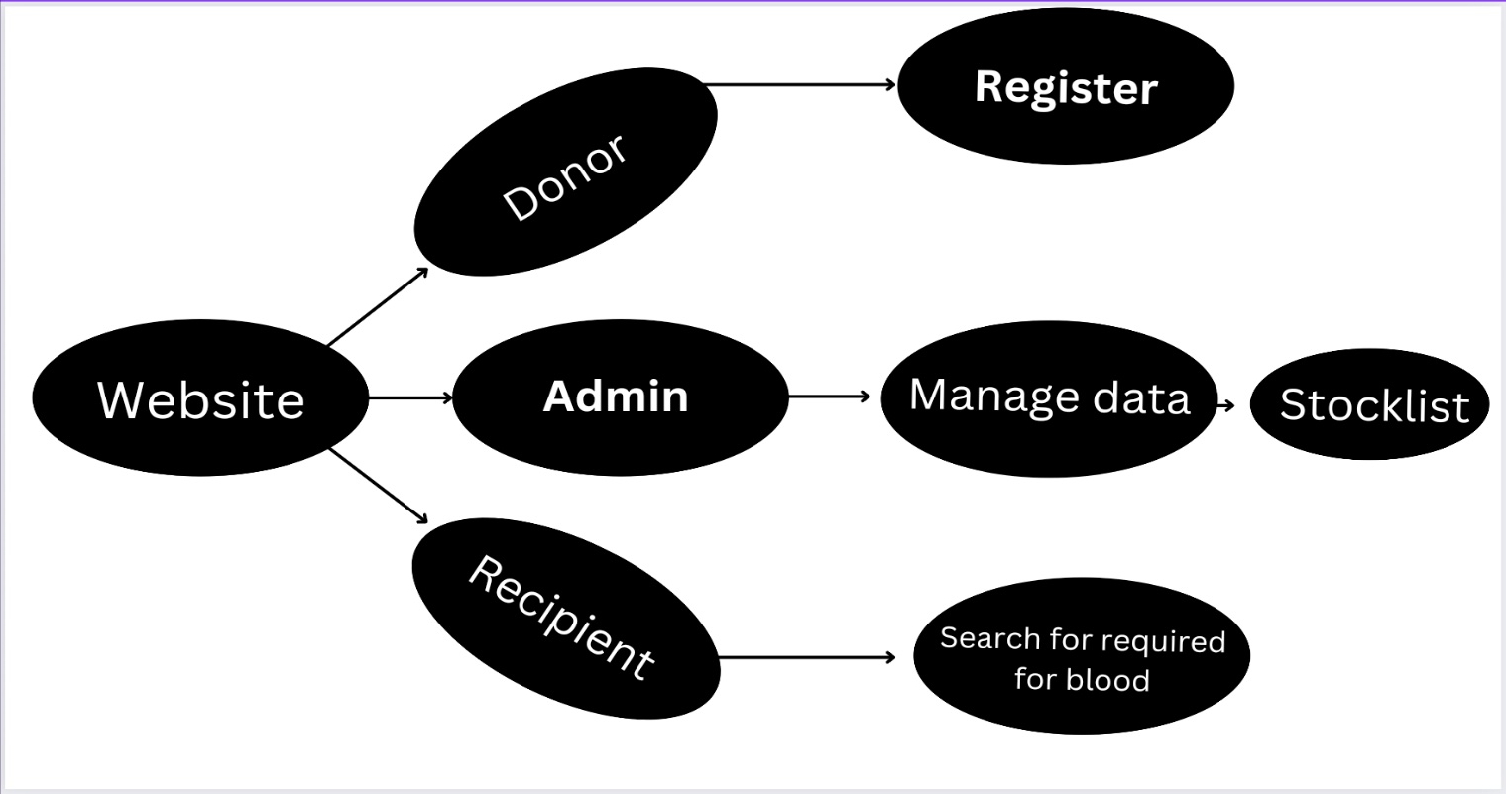
Project Title:-Blood Bank Management System
Author:- Prajakta Dandavate
EDAI1 PROJECT GROUP NO
Student’s Name :- Akhilesh Mane, Pratik Mane, Rushikesh Mane, Rutuja Mane,Tushar Mane,Yash Mane
06
Department of Engineering Sciences and Humanities (DESH) Vishwakarma Institute of Technology, Pune 25 Feb 2023 .
INTRODUCTION
ABSTRACT :
RESULTS
The need of availability of blood at right time, at right place to people.
Offline Blood Bank systems does not give much satisfactory results.
A online platform for blood bank to manage donor profiles and provides effective results to recipients .
INTRODUCTION
Ensure the timely and safe availability of blood products for patients in need.
The systems keeps track of blood donation and storage to enhance inventory control.
System simplify data entry and retrieval for blood bank staff.
METHODOLOGY
FEATURES
A web-based blood donation and search system was designed and implemented.
The system requires user authentication and offers options to search for blood or donate blood.
The system uses web development technologies and a MySQL database.
The admin(blood bank) can manage blood stock levels and donor data
The project is of the great benefit to the society.
Ensures blood banks have good supply / storage of blood bags.
Ability to manage the information of its blood donors and necessary changes at required time.
CONCLUSIONS
Blood Bank Management System can improve the quality of service offered to donors and recipients.
The system makes it easy to analyze data and identify trends in blood demand and donation.
With good planning and training,the awareness of rare blood groups can bring enormous benefits to recipient at emergency time.
SYSTEM ARCHITECTURE

